Slide 2
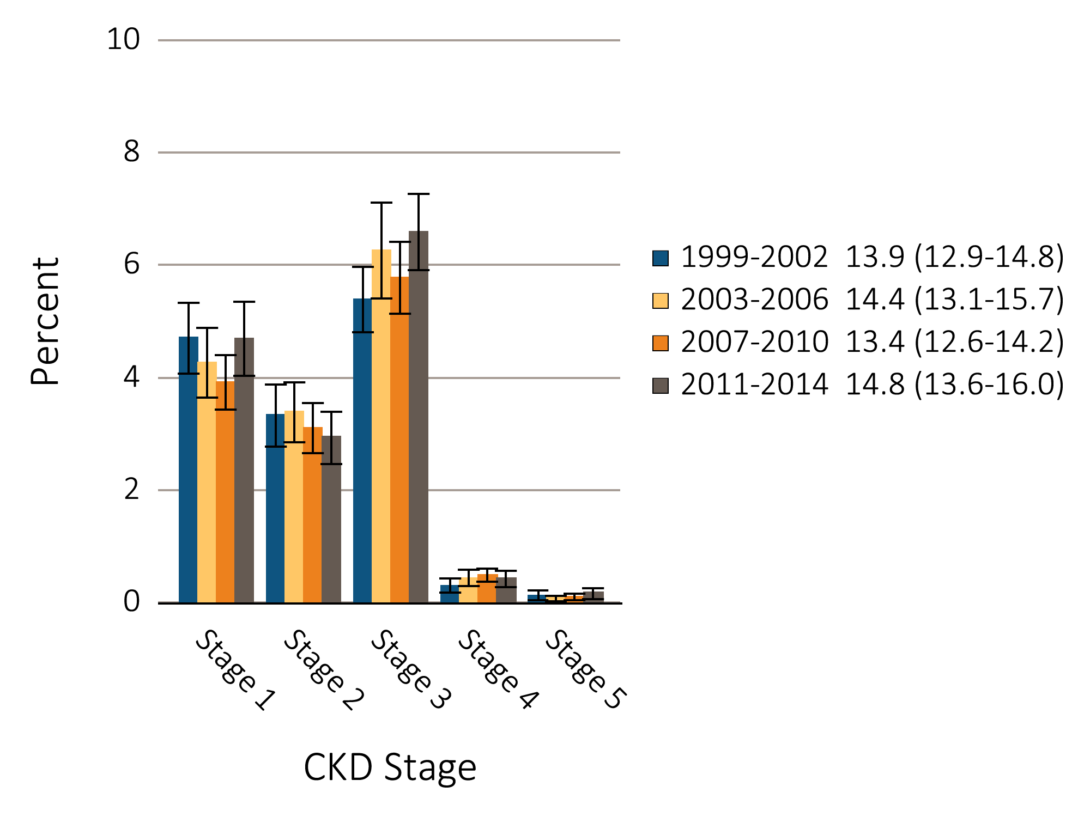
Figure 1.1 Prevalence of CKD by stage among NHANES participants,
1999-2014
Data Source: National Health and Nutrition Examination Survey (NHANES), 1999-2002, 2003-2006, 2007-2010 & 2011–2014 participants aged 20 & older. Whisker lines indicate 95% confidence intervals. Abbreviations: CKD, chronic kidney disease. .

Slide 3
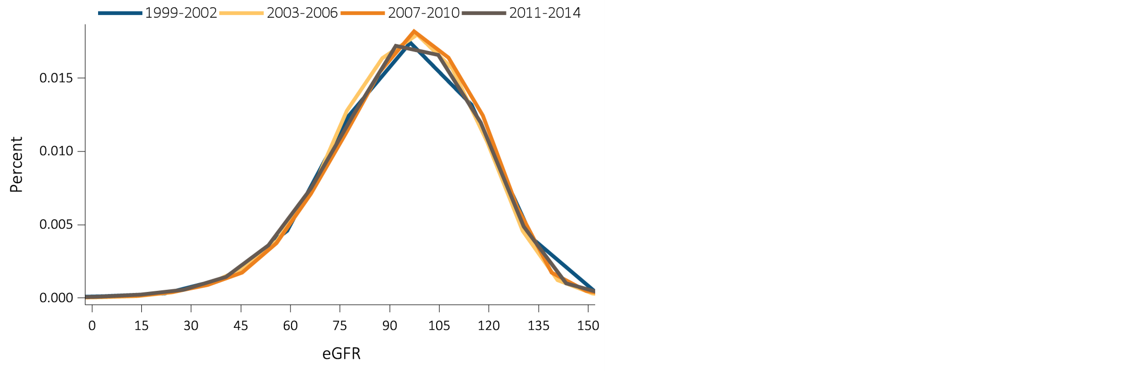
Figure 1.2 eGFR distribution among NHANES participants, 1999-2014
^{(a)} ^{All Individuals}
Data Source: National Health and Nutrition Examination Survey (NHANES), 1999-2014 participants aged 20 & older. Single-sample estimates of eGFR; eGFR calculated using the CKD-EPI equation. Abbreviations: eGFR, estimated glomerular filtration rate. Accounts for change in serum creatinine assays.

Slide 4
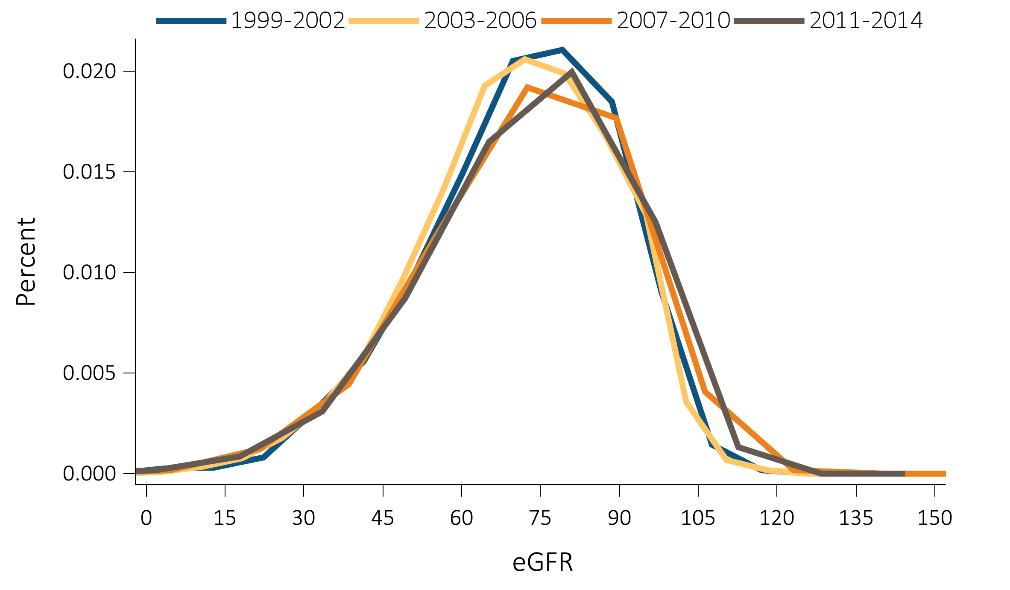
Figure 1.2 eGFR distribution among NHANES participants, 1999-2014
^{(b)} ^{Individuals 60+ years}
Data Source: National Health and Nutrition Examination Survey (NHANES), 1999-2014 participants aged 20 & older. Single-sample estimates of eGFR; eGFR calculated using the CKD-EPI equation. Abbreviations: eGFR, estimated glomerular filtration rate. Accounts for change in serum creatinine assays.

Slide 5
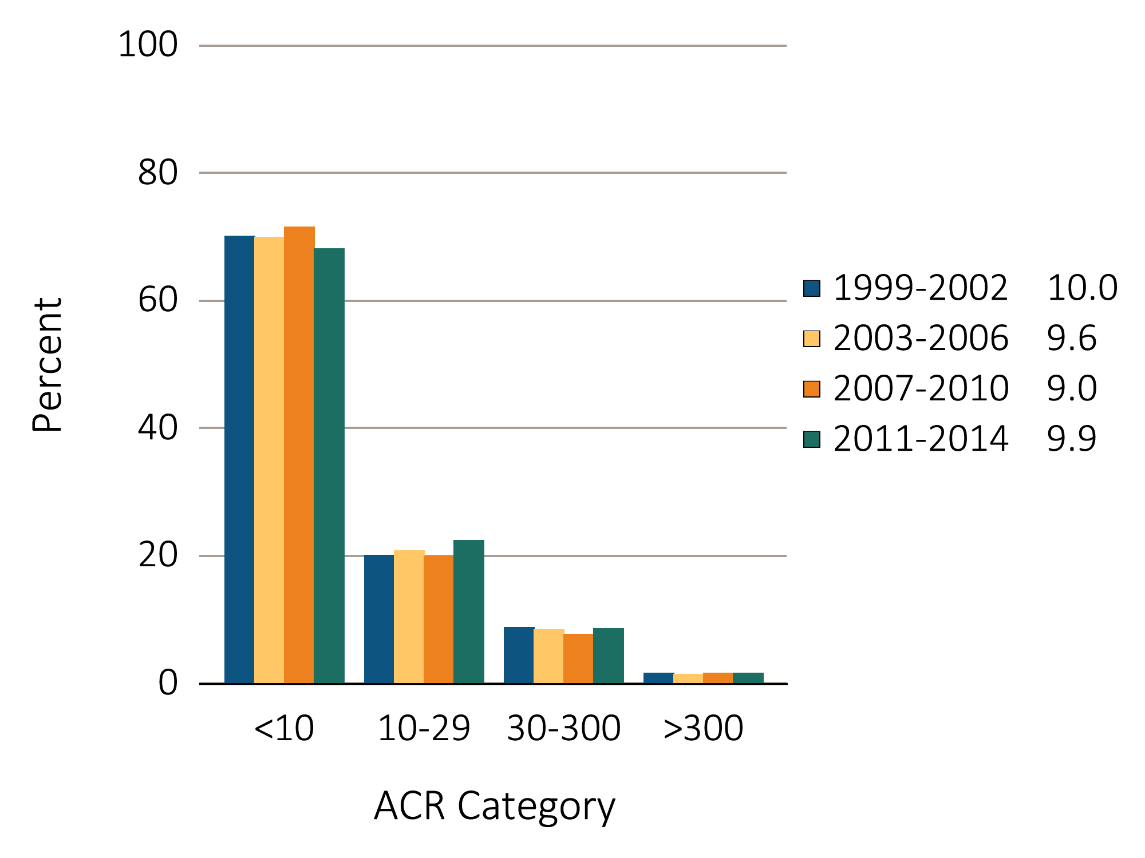
Figure 1.3 Urine albumin/creatinine ratio (ACR) distribution among NHANES participants, 1999-2014
Data Source: National Health and Nutrition Examination Survey (NHANES), 1999-2014 participants aged 20 & older. Single-sample estimates of ACR. Abbreviations: ACR, urine albumin (mg)/creatinine(g) ratio.

Slide 6
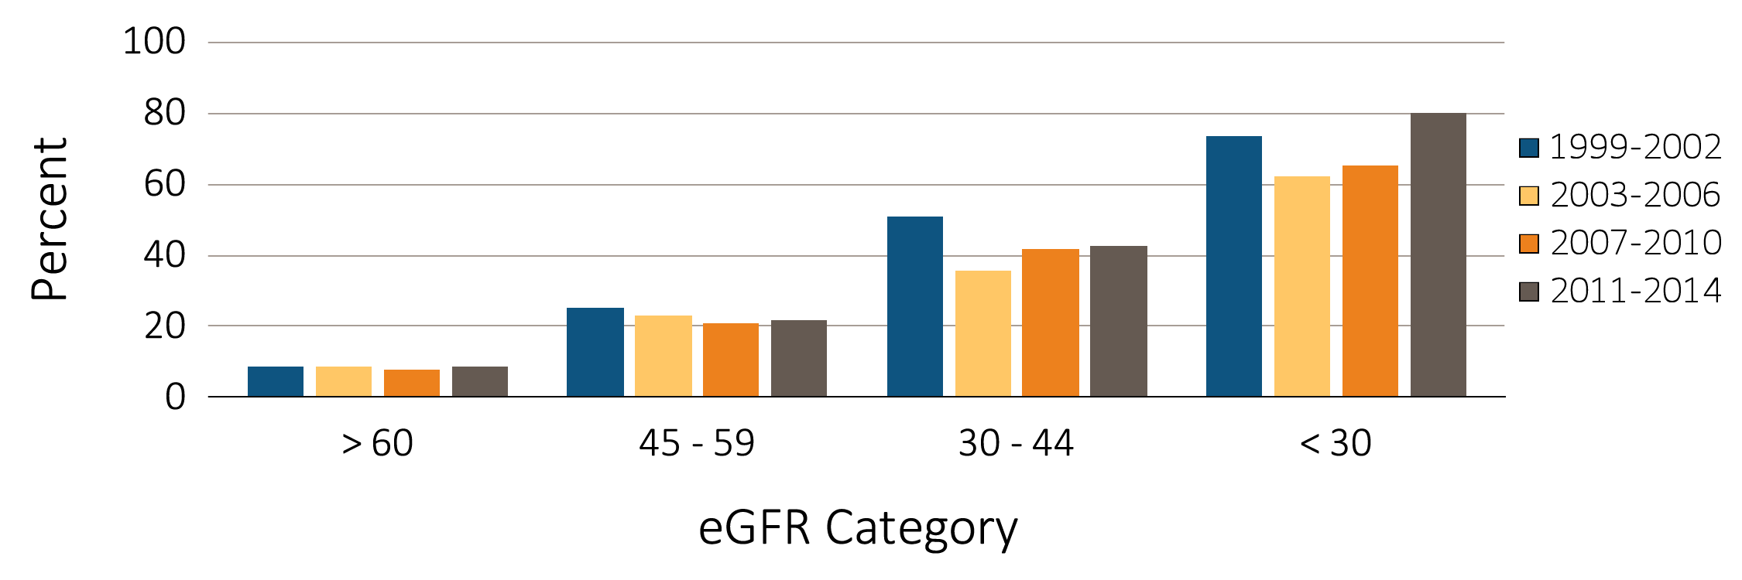
Figure 1.4 Percentage of NHANES (1999-2014) participants with ACR > 30 mg/g, by eGFR category
Data Source: National Health and Nutrition Examination Survey (NHANES), 1999-2014 participants aged 20 & older. Single-sample estimates of ACR. Abbreviations: ACR, urine albumin (mg)/creatinine(g) ratio.

Slide 7
Table 1.1 Percentage of NHANES (1999-2014) participants, in the various CKD (eGFR and albuminuria) risk categories (KDIGO 2012)
(a) Percentage in each category (2011-2014)
 |  |  |  | Albuminuria categories
 |  |  |  | A1 | A2 | A3
 |  |  |  | Normal to mildly increased | Moderately increased | Severely increased
 |  |  |  | <30 mg/g <3 mg/mmol | 30-300 mg/g 3-30 mg/mmol | >300 mg/g >30 mg/mmol
GFR categories (ml/min/1.73 m²) | G1 | Normal to high | ≥ 90 | 54.7 | 4.3 | 0.4
 | G2 | Mildly decreased | 60-89 | 30.4 | 2.6 | 0.3
 | G3a | Mildly to moderately decreased | 45-59 | 3.9 | 0.9 | 0.2
 | G3b | Moderately to severely decreased | 30-44 | 1.0 | 0.5 | 0.2
 | G4 | Severely decreased | 15-29 | 0.1 | 0.1 | 0.2
 | G5 | Kidney failure | < 15 | <0.001 | 0.001 | 0.01

Slide 8
Table 1.1 Percentage of NHANES (1999-2014) participants, in the various CKD (eGFR and albuminuria) risk categories (KDIGO 2012)
(b) Summary of prevalence in each risk category by cohort (1999-2014)
Data source: National Health and Nutrition Examination Survey (NHANES), 1999-2002, 2003-2006, 2007-2010 & 2011–2014 participants aged 20 and older. Single-sample estimates of eGFR and ACR; eGFR calculated using the CKD-EPI equation. Abbreviations: ACR, urine albumin/creatinine ratio; CKD, chronic kidney disease; eGFR, estimated glomerular filtration rate; GFR, glomerular filtration rate; KDIGO, Kidney Disease: Improving Global Outcomes CKD Work Group. Low risk: eGFR ≥60 ml/min/1.73 m2 and ACR <30 mg/g; moderately high risk: eGFR 45-59 ml/min/1.73 m2 or eGFR ≥60 ml/min/1.73 m2 and ACR 30-300 mg/g; high risk: eGFR 30-44 ml/min/1.73 m2 or eGFR 45-59 ml/min/1.73 m2 and ACR 30-300 mg/g or eGFR ≥60 ml/min/1.73 m2 and ACR >300 mg/g; very high risk: eGFR <30 ml/min/1.73 m2 or eGFR 30-44 ml/min/1.73 m2 and ACR 30-300 mg/g or eGFR ≥60 ml/min/1.73 m2 and ACR >300 mg/g.

Slide 9
Table 1.2 Prevalence (%) of CKD in NHANES population within age, sex, race/ethnicity, &risk-factor categories, 1999-2014
 | All CKD |  |  |  | eGFR <60ml/min/1.73m² |  |  |  | ACR ≥30 mg/g
 | 1999-2002 | 2003-2006 | 2007-2012 | 2011-2014 | 1999-2002 | 2003-2006 | 2007-2012 | 2011-2014 | 1999-2002 | 2003-2006 | 2007-2012 | 2011-2014
Age
20-39 | 6.0 | 5.9 | 5.4 | 6.6 | 0.4 | 0.1 | 0.3 | 0.3 | 5.9 | 5.8 | 5.3 | 6.4
40-59 | 10.0 | 9.8 | 8.5 | 10.6 | 1.9 | 2.3 | 2.0 | 3.3 | 8.6 | 8.2 | 7.0 | 8.5
60+ | 36.9 | 37.1 | 33.6 | 32.6 | 24.0 | 25.8 | 22.9 | 22.6 | 21.3 | 18.4 | 17.7 | 16.8
Sex
Male | 12.0 | 12.6 | 11.7 | 13.0 | 4.8 | 5.7 | 5.2 | 6.4 | 9.1 | 8.9 | 8.4 | 8.8
Female | 15.6 | 16.1 | 15.0 | 16.5 | 6.8 | 7.8 | 7.5 | 7.9 | 10.9 | 10.2 | 9.4 | 10.9
Race/Ethnicity
Non-Hispanic White | 13.9 | 14.3 | 13.8 | 15.2 | 6.6 | 7.9 | 7.5 | 8.5 | 9.3 | 8.5 | 8.4 | 9.0
Non-Hispanic Black/African American | 15.1 | 15.8 | 14.8 | 16.9 | 5.3 | 5.2 | 5.8 | 6.2 | 12.7 | 13.0 | 11.2 | 13.5
Mexican American | 11.6 | 11.6 | 11.8 | 12.5 | 1.4 | 1.6 | 2.3 | 2.5 | 10.4 | 10.9 | 10.5 | 11.2
Other Hispanic | 13.8 | 15.5 | 11.4 | 12.8 | 3.6 | 3.5 | 3.3 | 4.3 | 11.7 | 13.3 | 9.5 | 10.5
Other Non-Hispanic | 14.0 | 16.2 | 10.6 | 12.8 | 3.9 | 4.2 | 3.1 | 4.3 | 12.1 | 13.5 | 9.1 | 10.3
Risk Factor
Diabetes | 41.2 | 41.5 | 39.0 | 39.4 | 15.1 | 19.2 | 18.7 | 20.7 | 34.8 | 30.9 | 28.4 | 28.7
Self-reported diabetes | 40.8 | 43.0 | 40.6 | 40.6 | 16.5 | 20.3 | 19.9 | 22.3 | 33.5 | 31.7 | 29.5 | 29.5
Hypertension | 33.4 | 31.7 | 30.6 | 32.1 | 16.8 | 17.4 | 16.9 | 17.7 | 23.0 | 19.6 | 19.1 | 20.6
Self-reported hypertension | 28.2 | 26.9 | 25.7 | 26.9 | 16.3 | 15.3 | 15.0 | 15.8 | 17.7 | 16.5 | 15.7 | 16.6
Self-reported cardiovascular disease | 38.2 | 43.5 | 37.2 | 42.6 | 26.7 | 29.3 | 25.1 | 29.3 | 22.7 | 24.8 | 22.3 | 25.5
Obesity (BMI >30) | 17.2 | 16.8 | 16.1 | 17.6 | 6.3 | 7.1 | 7.0 | 7.9 | 13.2 | 11.9 | 11.1 | 12.5
All | 13.9 | 14.4 | 13.4 | 14.8 | 5.8 | 6.8 | 6.4 | 7.2 | 10.1 | 9.6 | 8.9 | 9.9
Data source: National Health and Nutrition Examination Survey (NHANES), 1999-2002, 2003-2006, 2007-2010 & 2011-2014 participants age 20 & older. Single-sample estimates of eGFR & ACR; eGFR calculated using the CKD-EPI equation. Diabetes defined as HbA1c >7 percent, self-reported (SR), or currently taking glucose-lowering medications. Hypertension defined as BP ≥130/≥80 for those with diabetes or CKD, otherwise BP ≥140/≥90, or taking medication for hypertension. Values in Figure 1.12 cannot be directly compared to those in Table 1.3 due to different Survey cohorts. The table represents NHANES participants who are classified as hypertensive (measured/treated) but some of those are at target blood pressure. Abbreviations: ACR, urine albumin/creatinine ratio; BMI, body mass index; BP, blood pressure, CKD, chronic kidney disease; eGFR, estimated glomerular filtration rate.

Slide 10
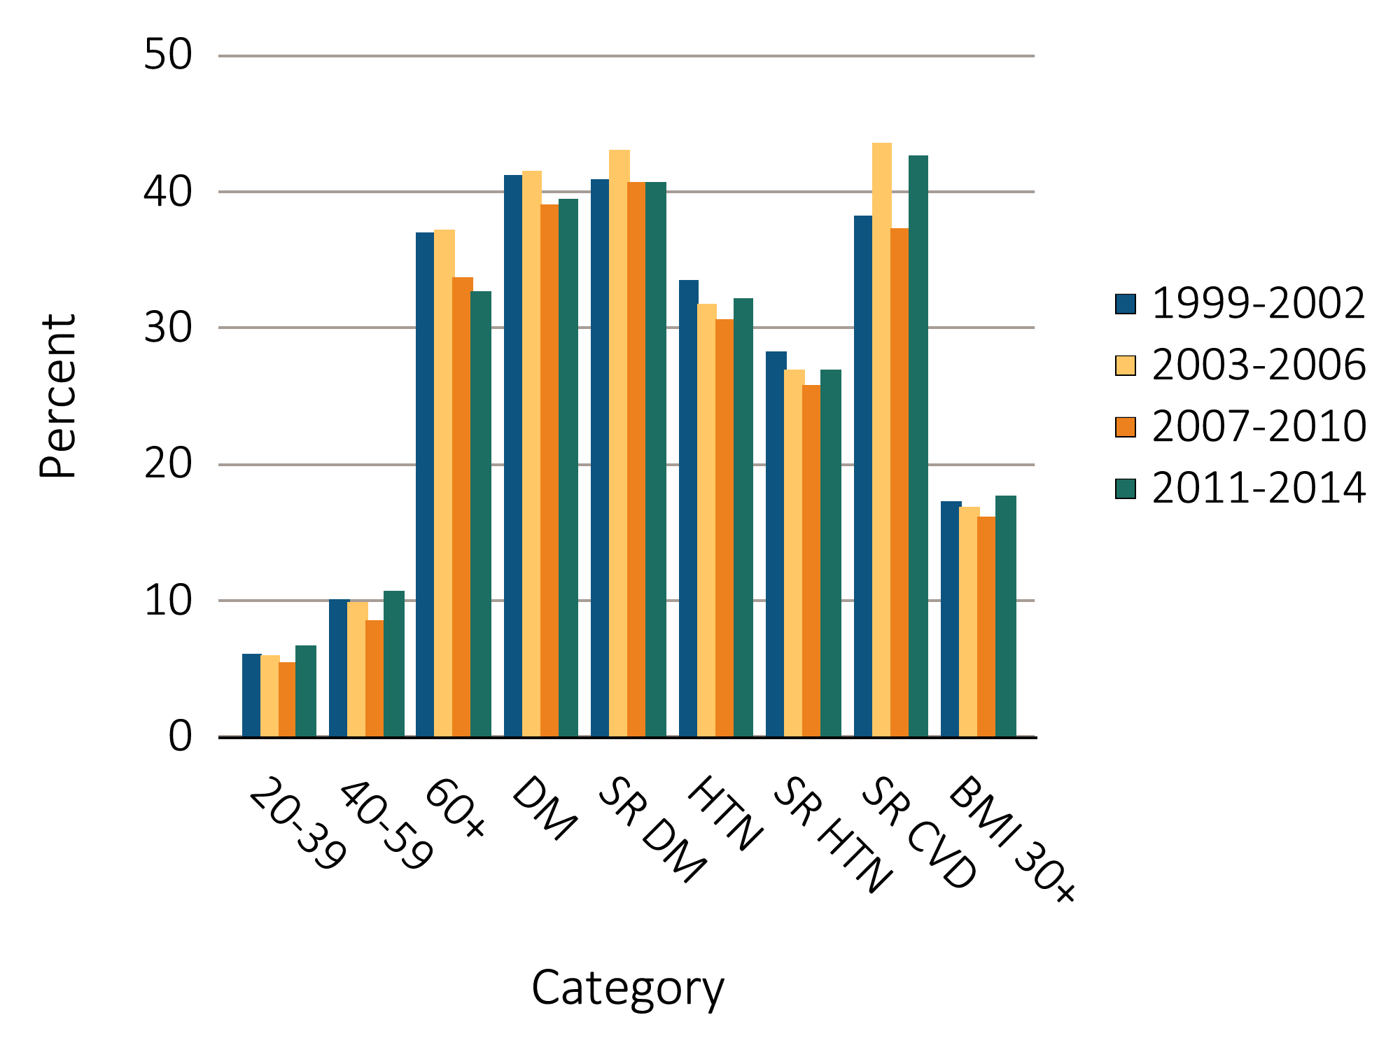
Figure 1.5 Prevalence of CKD by age & risk factor among NHANES participants, 1999-2014
Data Source: National Health and Nutrition Examination Survey (NHANES), 1999–2014 participants age 20 & older. Single-sample estimates of eGFR & ACR; eGFR calculated using the CKD-EPI equation. Diabetes defined as HbA1c >7 percent, self-reported, or currently taking glucose-lowering medications. Hypertension defined as BP ≥130/≥80 for those with diabetes or CKD, otherwise BP ≥140/≥90, or taking medication for hypertension. Abbreviations: ACR, urine albumin/creatinine ratio; BMI, body mass index; CKD, chronic kidney disease; CVD, cardiovascular disease; DM, diabetes mellitus; eGFR, estimated glomerular filtration rate; HTN, hypertension; SR, self-reported.

Slide 11
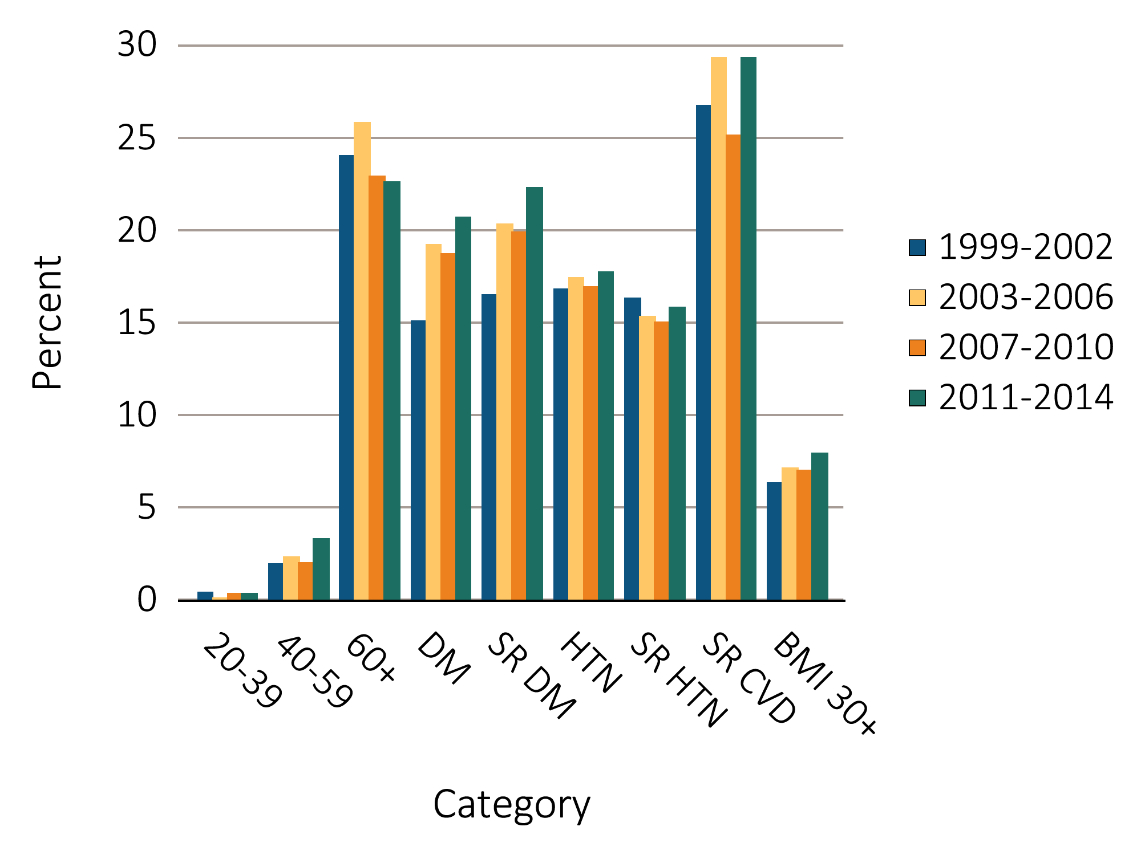
Figure 1.6 NHANES participants with eGFR <60 ml/min/1.73 m2, by age & risk factor,
¹⁹⁹⁹⁻²⁰¹⁴
Data Source: National Health and Nutrition Examination Survey (NHANES), 1999–2002, 2003-2006, 2007-2010, & 2011–2014 participants age 20 & older. Single-sample estimates of eGFR & ACR; eGFR calculated using the CKD-EPI equation. Diabetes defined as HbA1c >7 percent, self-reported (SR), or currently taking glucose-lowering medications. Hypertension defined as BP ≥130/≥80 for those with diabetes or CKD, otherwise BP ≥140/≥90, or taking medication for hypertension. Abbreviations: ACR, urine albumin/creatinine ratio; BMI, body mass index; CVD, cardiovascular disease; DM, diabetes mellitus; eGFR, estimated glomerular filtration rate; HTN, hypertension; SR, self-reported.

Slide 12
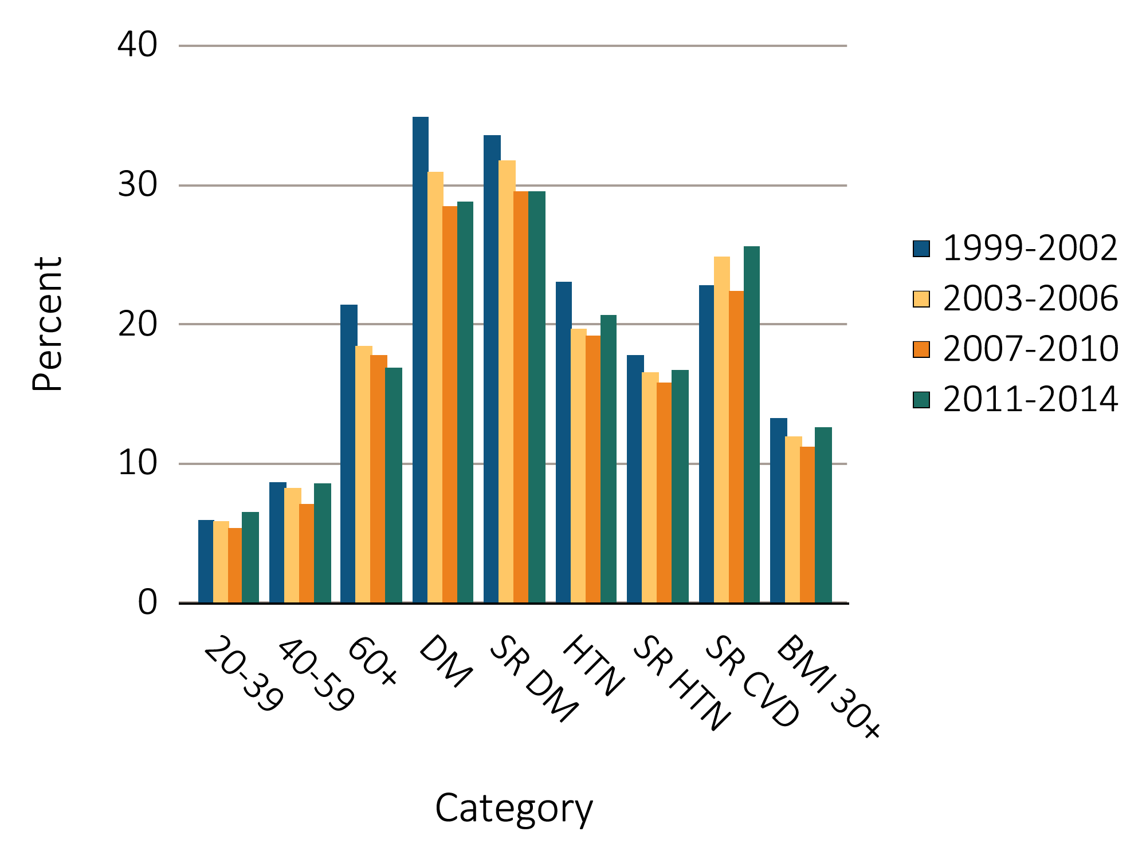
Figure 1.7 NHANES participants with urine albumin/creatinine ratio ≥30 mg/g, by age & risk factor, 1999-2014
Data source: National Health and Nutrition Examination Survey (NHANES), 1999–2002, 2003-2006, 2007-2010 & 2011–2014 participants age 20 & older. Single-sample estimates of eGFR & ACR; eGFR calculated using the CKD-EPI equation. Diabetes defined as HbA1c >7 percent, self-reported (SR), or currently taking glucose-lowering medications. Hypertension defined as BP ≥130/≥80 for those with diabetes or CKD, otherwise BP ≥140/≥90, or taking medication for hypertension. Abbreviations: ACR, urine albumin/creatinine ratio; BMI, body mass index; CKD, chronic kidney disease; CVD, cardiovascular disease; DM, diabetes mellitus; eGFR, estimated glomerular filtration rate; HTN, hypertension; SR, self-report.

Slide 13
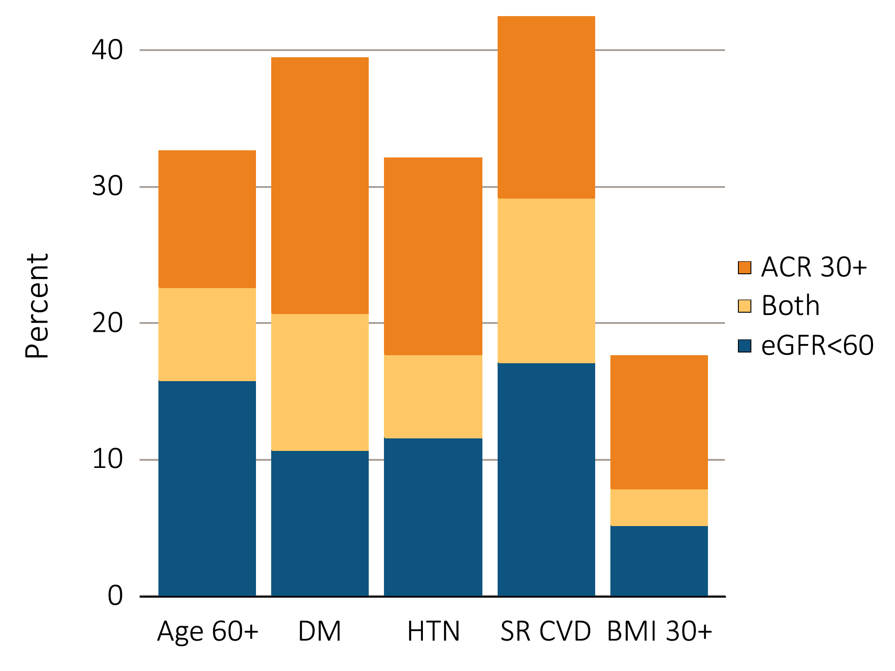
Figure 1.8 Distribution of markers of CKD in NHANES participants with diabetes, hypertension, self-reported cardiovascular disease, & obesity, 2011–2014
Data Source: National Health and Nutrition Examination Survey (NHANES), 2011–2014 participants age 20 & older. Single-sample estimates of eGFR & ACR; eGFR calculated using the CKD-EPI equation. Abbreviations: ACR, urine albumin/creatinine ratio; BMI, body mass index; CKD, chronic kidney disease; SR CVD, self-reported cardiovascular disease; eGFR, estimated glomerular filtration rate; HTN, hypertension.

Slide 14
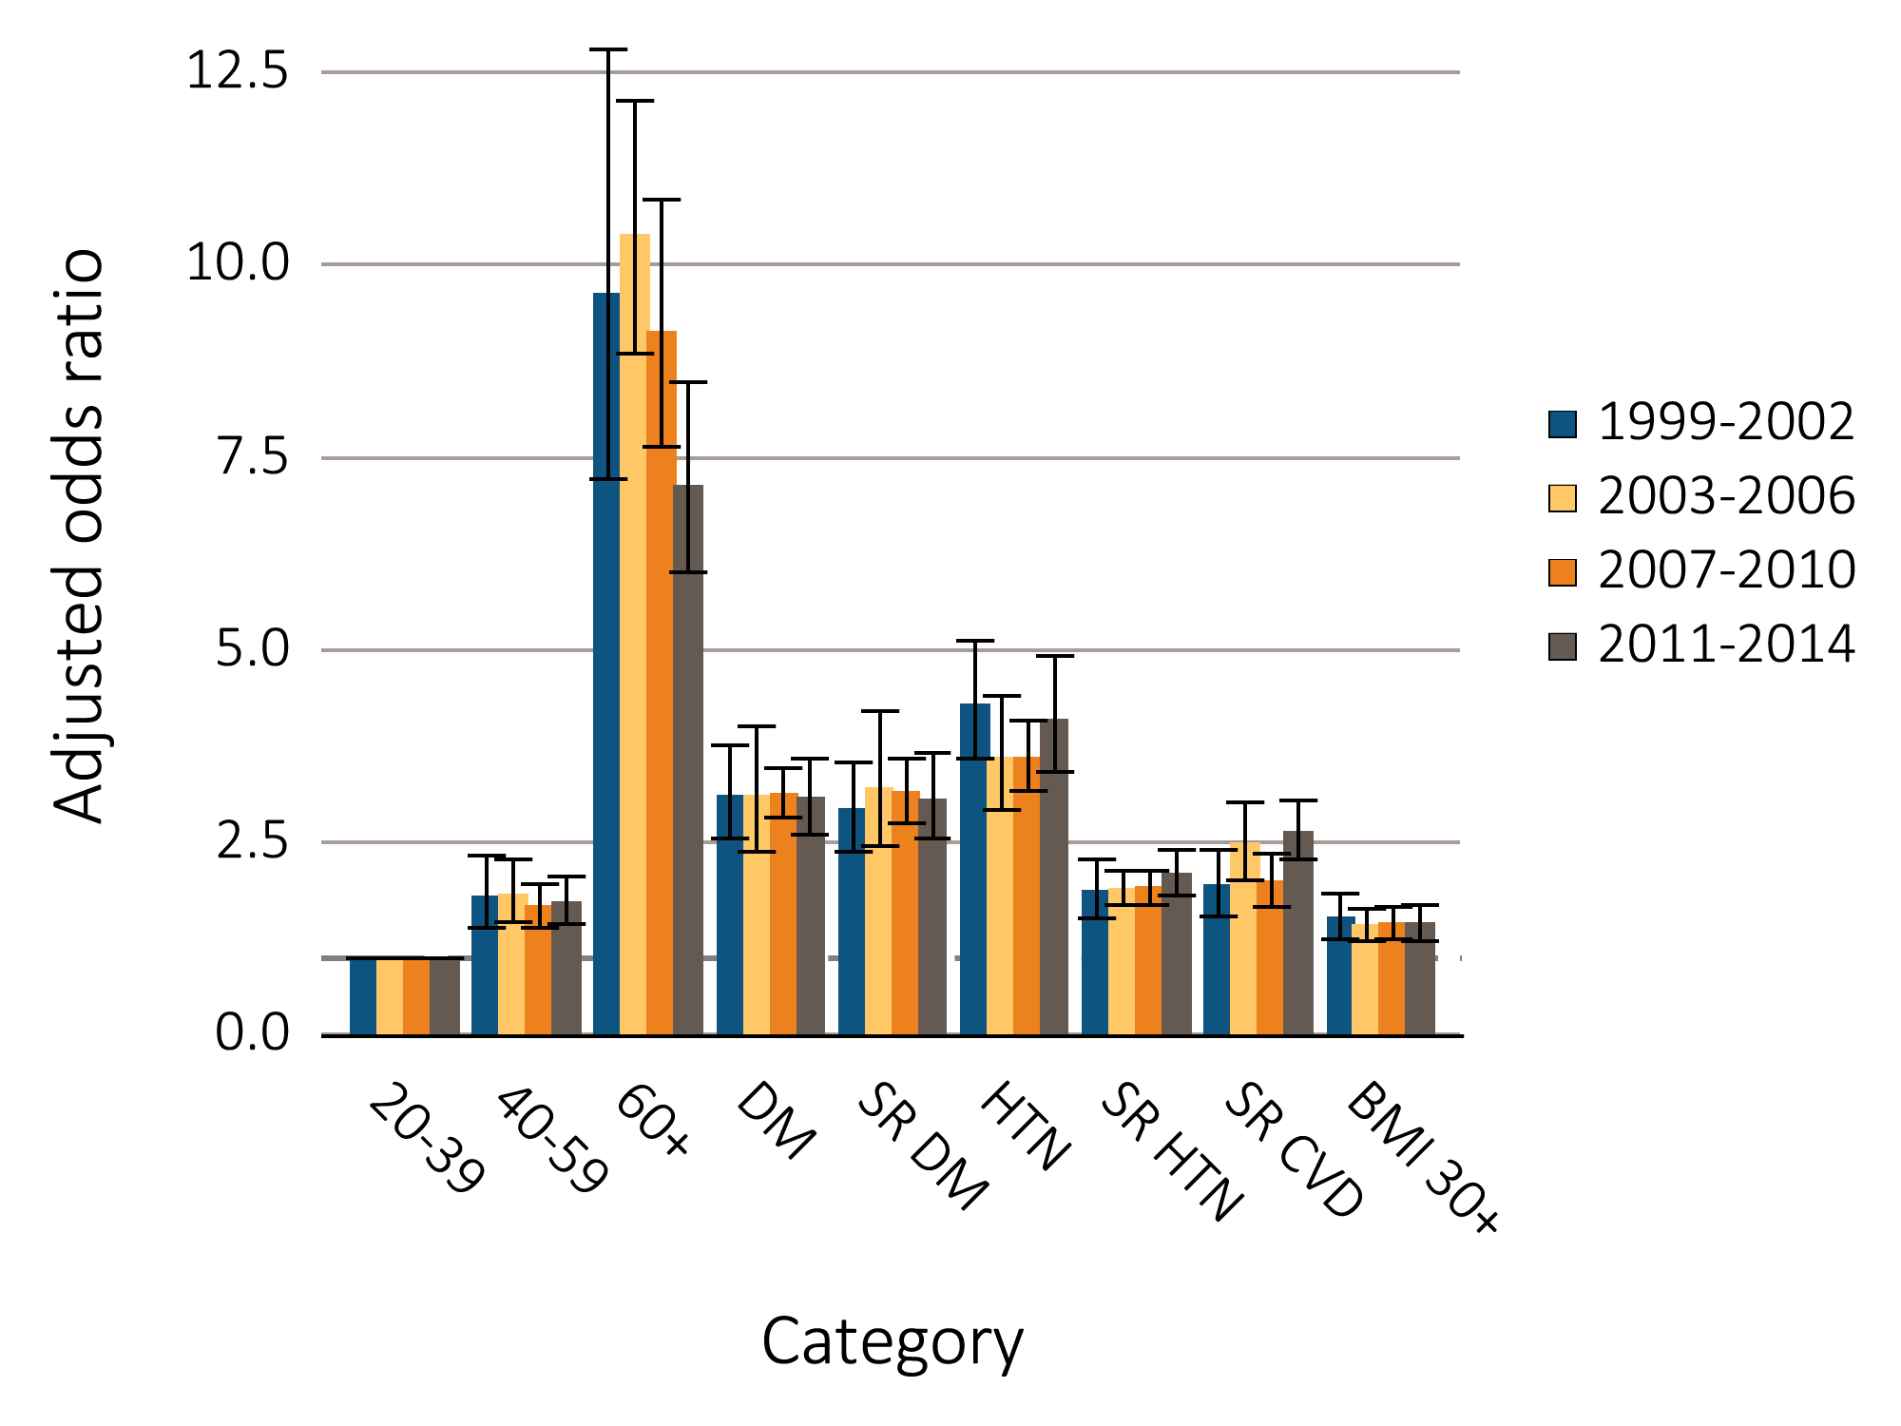
Figure 1.9 Adjusted odds ratios of CKD in NHANES participants by risk factor, 1999-2014
Data Source: National Health and Nutrition Examination Survey (NHANES), 1999–2002, 2003-2006, 2007-2010 & 2011–2014 participants age 20 & older; single-sample estimates of eGFR & ACR. Adj: age, sex, & race; eGFR calculated using the CKD-EPI equation. Whisker lines indicate 95% confidence intervals. Abbreviations: ACR, urine albumin/creatinine ratio; BMI, body mass index; CKD, chronic kidney disease; CVD, cardiovascular disease; DM, diabetes mellitus; eGFR, estimated glomerular filtration rate; HTN, hypertension; SR, self-report.

Slide 15
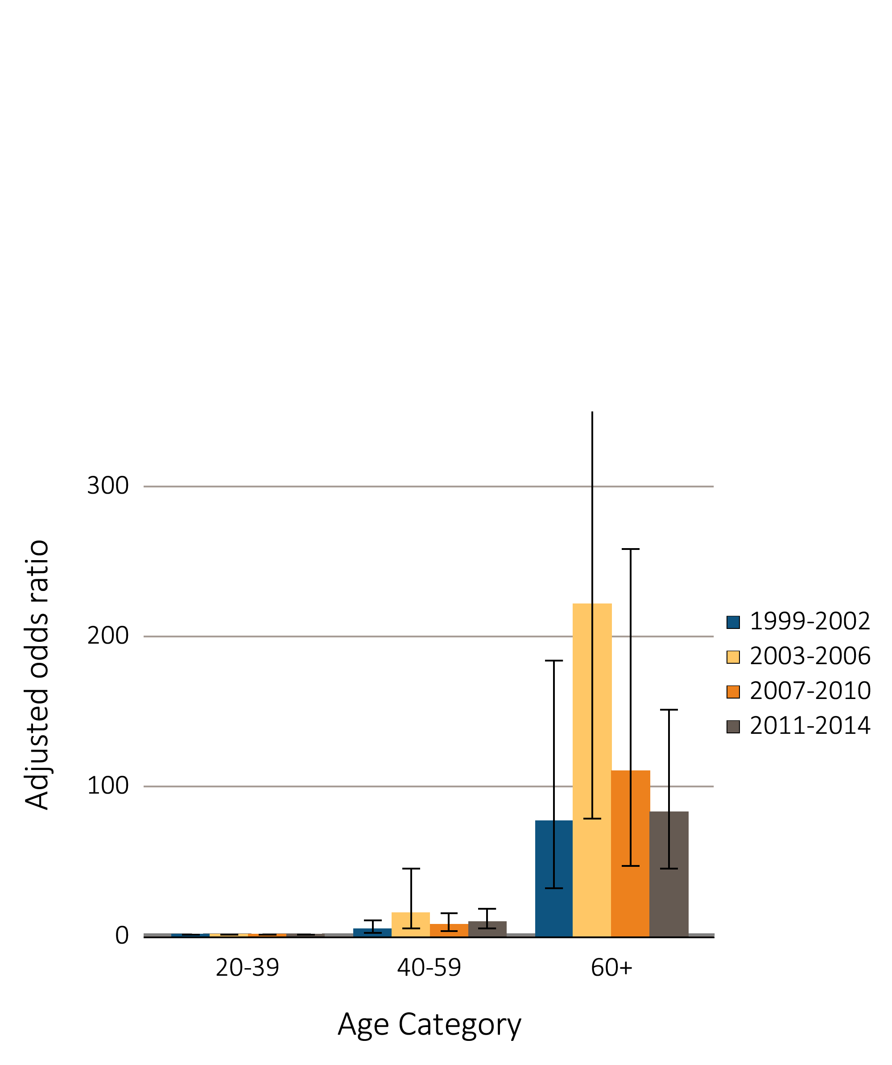
Figure 1.10 Adjusted odds ratios of eGFR <60 ml/min/1.73m2 in NHANES participants by age & risk factor, 1999-2014
^{(a)} ^{Age category}
Data Source: National Health and Nutrition Examination Survey (NHANES), 1999–2002, 2003-2006, 2007-2010 & 2011–2014 participants age 20 & older; single-sample estimates of eGFR & ACR. Adj: age, sex, & race; eGFR calculated using the CKD-EPI equation. Whisker lines indicate 95% confidence intervals. Abbreviations: ACR, urine albumin/creatinine ratio; BMI, body mass index; CKD, chronic kidney disease; CVD, cardiovascular disease; DM, diabetes mellitus; eGFR, estimated glomerular filtration rate; HTN, hypertension; SR, self-report.

Slide 16
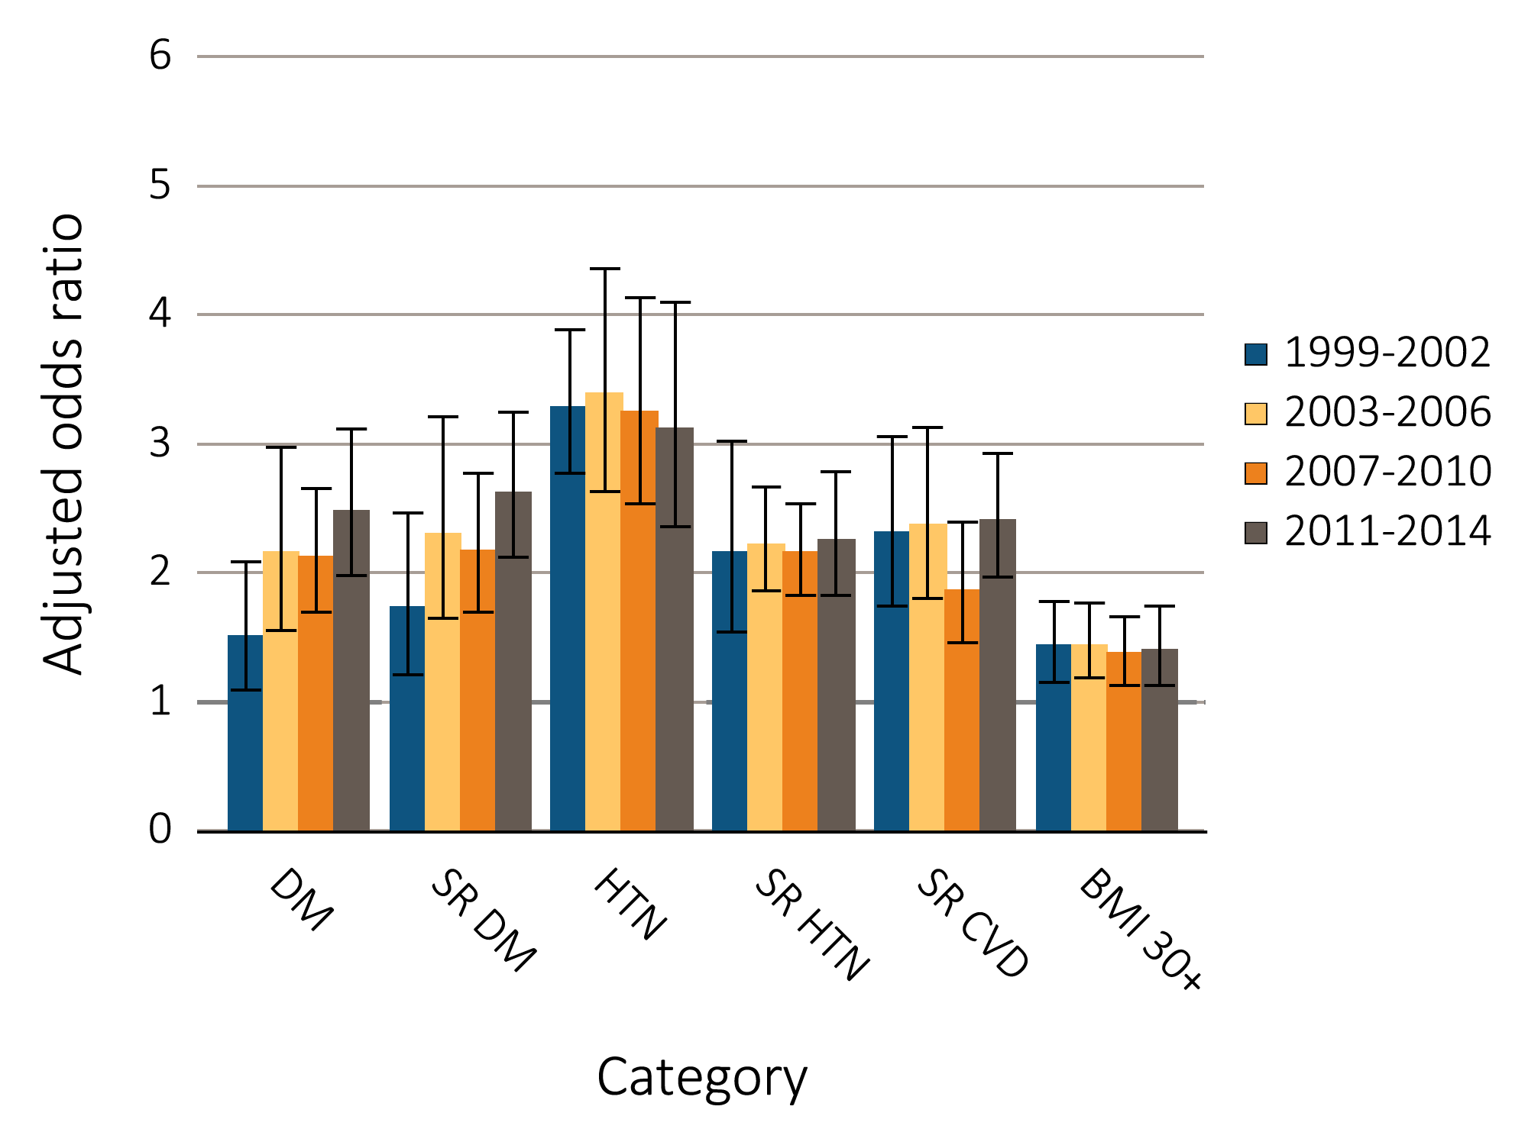
Figure 1.10 Adjusted odds ratios of eGFR <60 ml/min/1.73m2 in NHANES participants by age & risk factor, 1999-2014
^{(b)CKD risk factor}
Data Source: National Health and Nutrition Examination Survey (NHANES), 1999–2002, 2003-2006, 2007-2010 & 2011–2014 participants age 20 & older; single-sample estimates of eGFR & ACR. Adj: age, sex, & race; eGFR calculated using the CKD-EPI equation. Whisker lines indicate 95% confidence intervals. Abbreviations: ACR, urine albumin/creatinine ratio; BMI, body mass index; CKD, chronic kidney disease; CVD, cardiovascular disease; DM, diabetes mellitus; eGFR, estimated glomerular filtration rate; HTN, hypertension; SR, self-report.

Slide 17
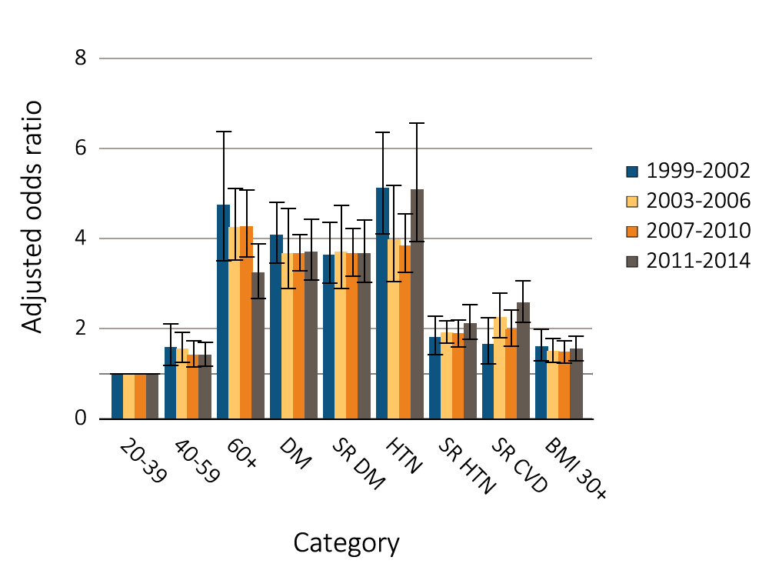
Figure 1.11 Adjusted odds ratios of urine albumin/creatinine ratio ≥30 mg/g in NHANES participants by age & risk factor, 1999-2014
Data Source: National Health and Nutrition Examination Survey (NHANES), 1999–2002, 2003-2006, 2007-2010 & 2011–2014 participants age 20 & older; single-sample estimates of eGFR & ACR. Adjusted: age, sex, & race; eGFR calculated using the CKD-EPI equation. Whisker lines indicate 95% confidence intervals. Abbreviations: ACR, urine albumin/creatinine ratio; BMI, body mass index; CKD, chronic kidney disease; CVD, cardiovascular disease; DM, diabetes mellitus; eGFR, estimated glomerular filtration rate; HTN, hypertension; SR, self-report.

Slide 18
(Continued on the next slide)

Slide 19
Table 1.3 Awareness, treatment, & measures of control of CKD risk factors, percent of NHANES participants, 1999-2014 (continued)
Data Source: National Health and Nutrition Examination Survey (NHANES), 1999–2002, 2003-2006, 2007-2010 & 2011–2014 participants age 20 & older. Single-sample estimates of eGFR & ACR; eGFR calculated using the CKD-EPI equation. Abbreviations: ACR, urine albumin/creatinine ratio; CKD, chronic kidney disease; eGFR, estimated glomerular filtration rate. a. Hypertension defined as blood pressure ≥130/≥80 for those with CKD and diabetes; otherwise ≥140/≥90, or self- reported treatment for hypertension. b. Awareness and treatment are self-reported. Control defined as <130/<80 for those with CKD and diabetes; otherwise <140/<90. c. Total cholesterol classified according to Adult Treatment Panel III blood cholesterol guidelines (ATP III). d. Glycohemoglobin classified according to American Diabetes Association guidelines

Slide 20
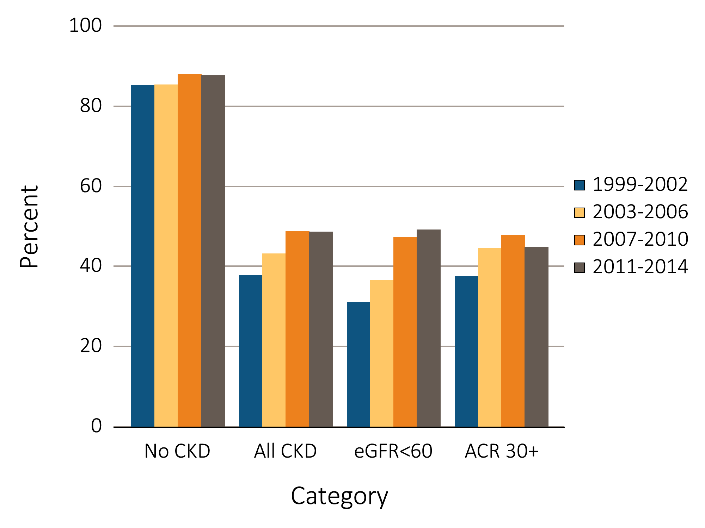
Figure 1.12 NHANES participants at target blood pressure, 1999-2014
Data Source: National Health and Nutrition Examination Survey (NHANES), 1999-2002, 2003-2006, 2007-2010 & 2011–2014 participants aged 20 & older. Single-sample estimates of eGFR & ACR; eGFR calculated using the CKD-EPI equation. Figure represents all hypertensive participants including those who were at target blood pressure, probably due to medication. Abbreviations: ACR, urine albumin/creatinine ratio; CKD, chronic kidney disease; eGFR, estimated glomerular filtration rate.

Slide 21
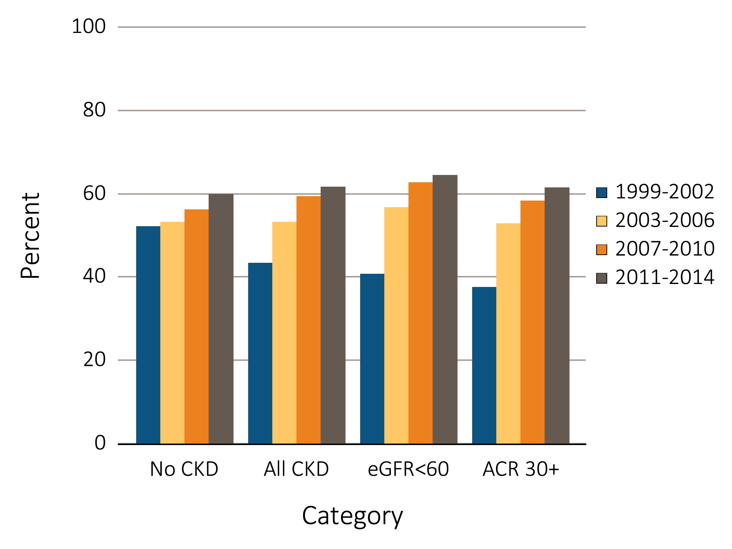
Figure 1.13 NHANES participants within cholesterol normal range, 1999-2014
Data Source: National Health and Nutrition Examination Survey (NHANES), 1999-2002, 2003-2006, 2007-2010 & 2011–2014 participants aged 20 & older. Single-sample estimates of eGFR & ACR; eGFR calculated using the CKD-EPI equation. Abbreviations: ACR, urine albumin/creatinine ratio; CKD, chronic kidney disease; eGFR, estimated glomerular filtration rate.

Slide 22
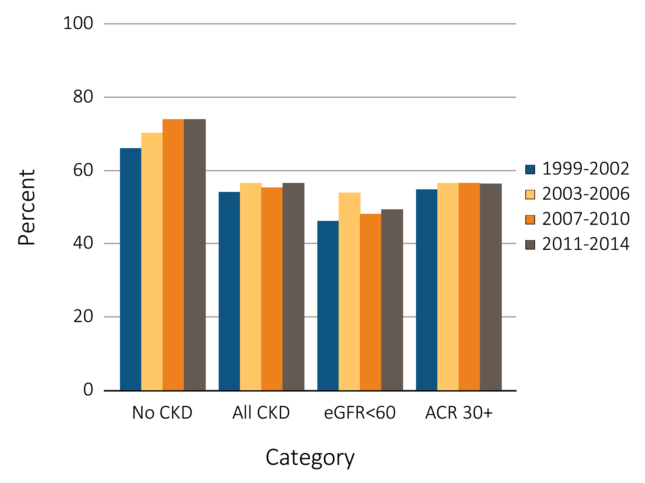
Figure 1.14 NHANES participants physically active, 1999-2014
Data Source: National Health and Nutrition Examination Survey (NHANES), 1999-2002, 2003-2006, 2007-2010 & 2011–2014 participants aged 20 & older. Single-sample estimates of eGFR & ACR; eGFR calculated using the CKD-EPI equation. Abbreviations: ACR, urine albumin/creatinine ratio; CKD, chronic kidney disease; eGFR, estimated glomerular filtration rate.

Slide 23
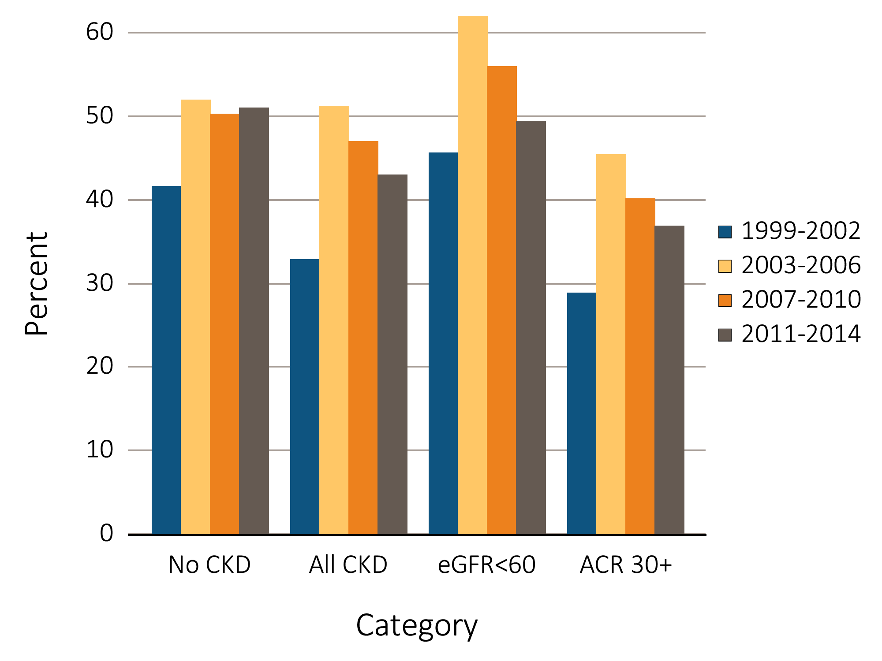
Figure 1.15 Diabetic NHANES participants with glycosylated hemoglobin <7%, 1999-2014
Data Source: National Health and Nutrition Examination Survey (NHANES), 1999-2002, 2003-2006, 2007-2010 & 2011–2014 participants aged 20 & older. Single-sample estimates of eGFR & ACR; eGFR calculated using the CKD-EPI equation. Abbreviations: ACR, urine albumin/creatinine ratio; CKD, chronic kidney disease; eGFR, estimated glomerular filtration rate.

Slide 24
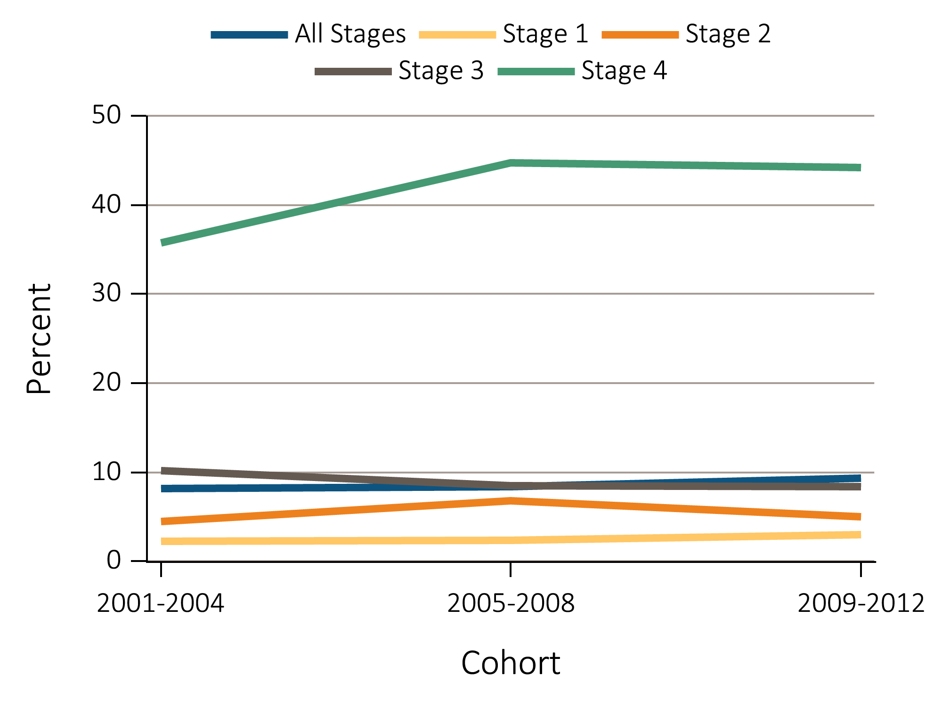
Figure 1.16 NHANES participants with CKD aware of their kidney disease, 2001-2012
^{(a)} ^{By stage}
Data Source: National Health and Nutrition Examination Survey (NHANES), 2001-2012 participants aged 20 & older. Abbreviations: CKD, chronic kidney disease.

Slide 25
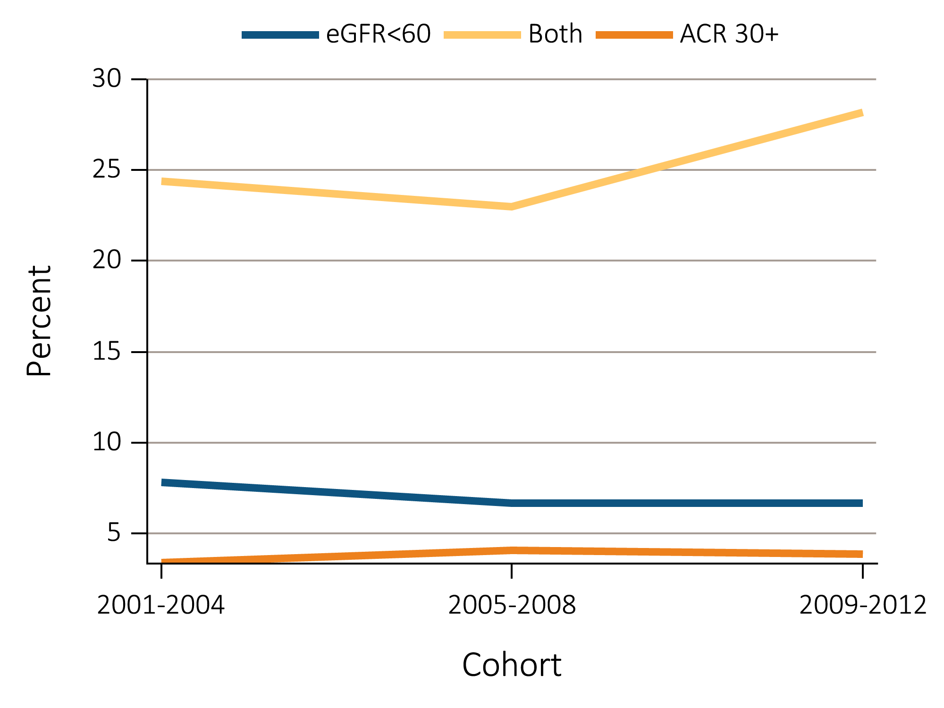
Figure 1.16 NHANES participants with CKD aware of their kidney disease, 2001-2012
^{(b)} By low eGFR and albuminuria status
Data Source: National Health and Nutrition Examination Survey (NHANES), 2001-2012 participants aged 20 & older. Abbreviations: CKD, chronic kidney disease.

Slide 26
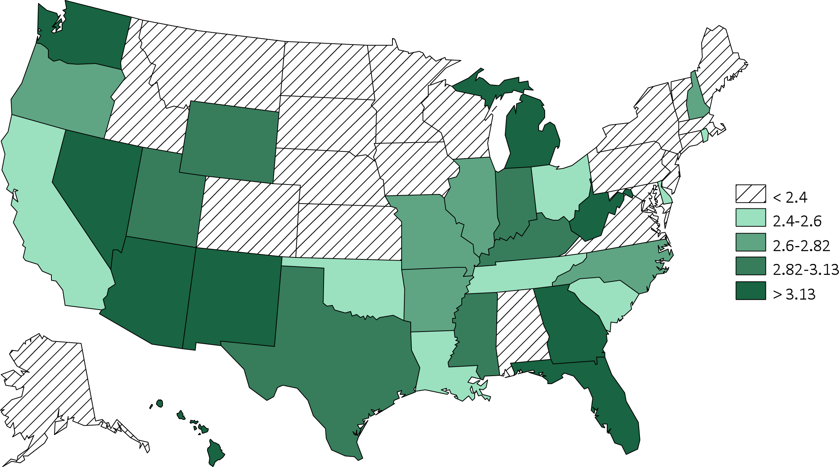
Figure 1.17 Estimated prevalence of self-reported kidney disease by state (%), BRFSS participants ages 18 and older, 2012 (N = 471,107) & 2014 (464,617).
^{(a) 2012}
Data source: Behavioral Risk Factors Surveillance System (BRFSS), 2012 participants aged 18 & older.

Slide 27
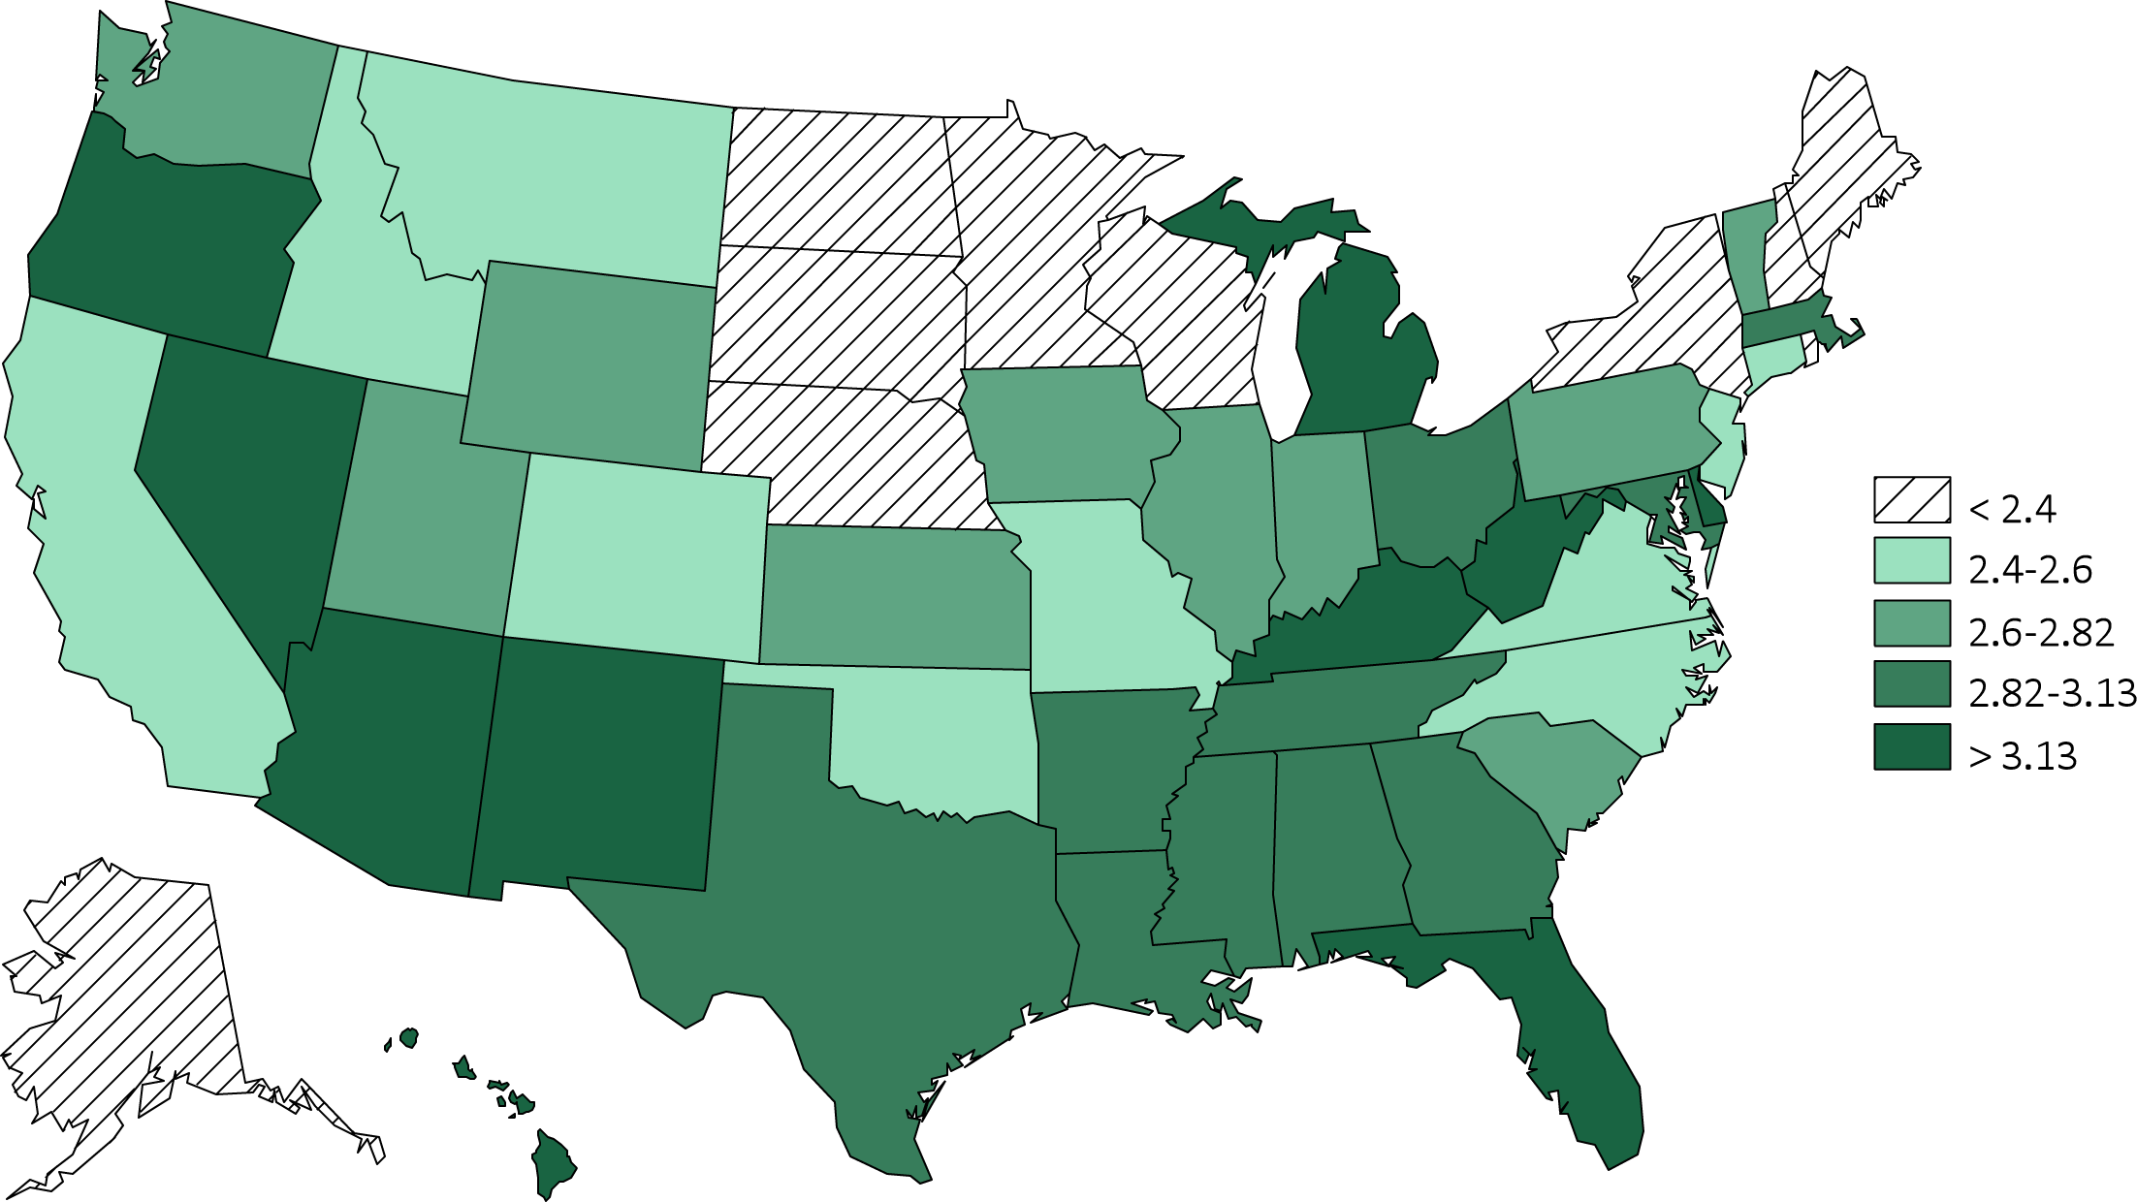
Figure 1.17 Estimated prevalence of self-reported kidney disease by state (%), BRFSS participants ages 18 and older, 2012 (N = 471,107) & 2014 (464,617).
^{(b) 2014}
Data source: Behavioral Risk Factors Surveillance System (BRFSS), 2012 participants aged 18 & older.

Slide 28
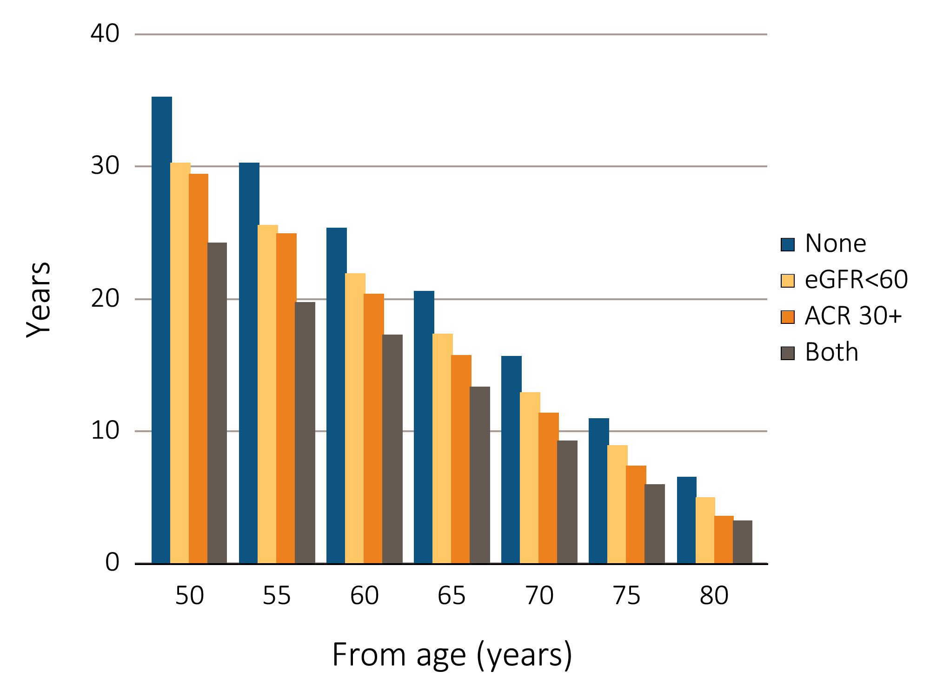
Figure 1.18 Life expectancy of NHANES participants with or without CKD, 1999–2011
Data source: NHANES 1999–2011 participants age 20 & older. Single-sample estimates of eGFR & ACR; eGFR calculated using the CKD-EPI equation.

